Slide 1
Statistics Statistics in the media
Year 10 Mathematics

Slide 2
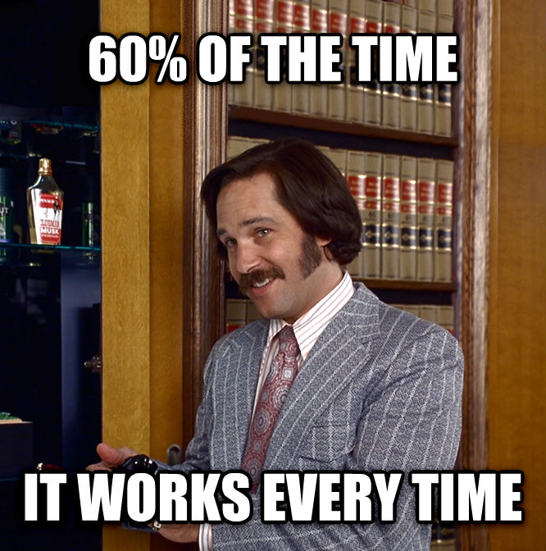

Slide 3
24
7
30
Topic: Statistics
Date: /06/2018
EQ – Can statistics tell lies?
There are 5 types of misuse of statistics
Faulty Polling - Specific wording patterns have a persuasive effect and induce respondents to answer in a predictable manner.
Flawed Correlation - studies can be manipulated (with enough data) to prove a correlation that does not exist
Data Fishing - extremely large volumes of data are analysed for the purposes of discovering relationships between data points that have no
Misleading Data Visualisation – If a graph doesn’t show the scale used, the starting value and the method of calculation you should not trust it
Purposeful Bias - the deliberate attempt to influence data findings without even feigning professional accountability

Slide 4
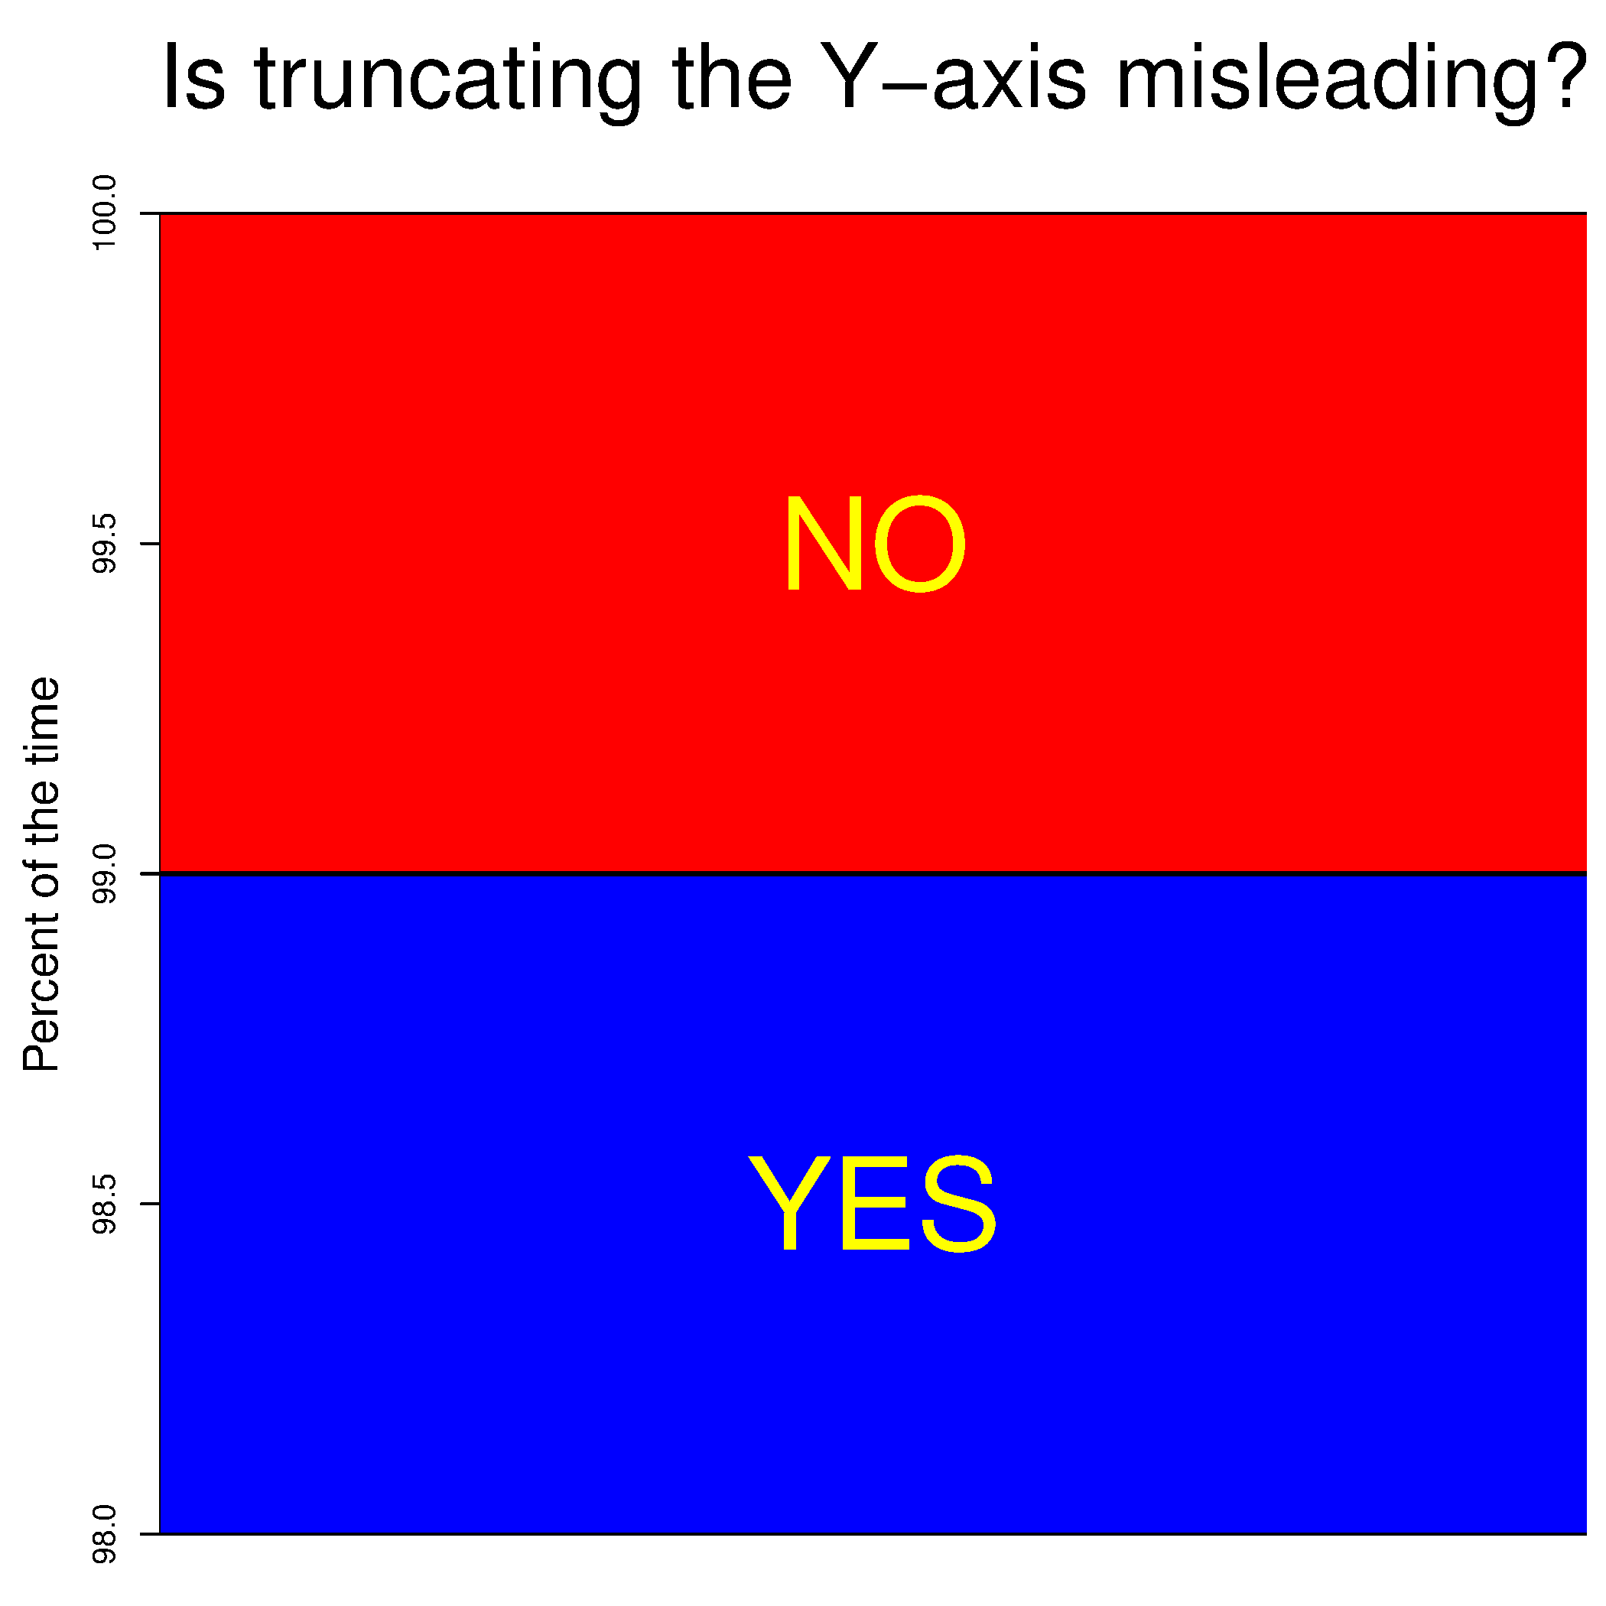
24
7
30
Topic: Statistics
Date: /06/2018
EQ – Can statistics tell lies?

Slide 5
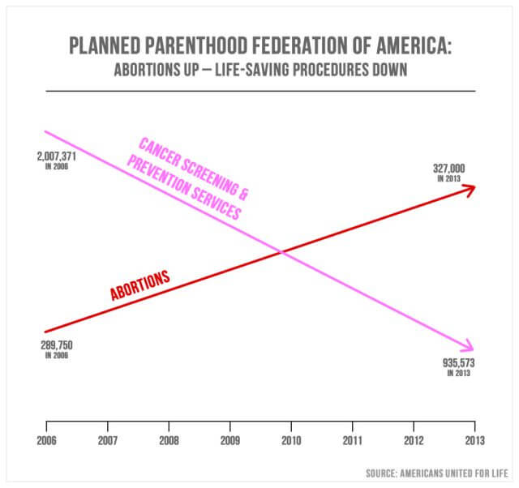
24
7
30
Topic: Statistics
Date: /06/2018
EQ – Can statistics tell lies?

Slide 6
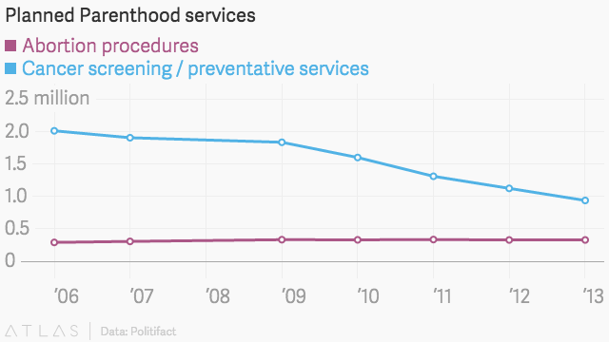
24
7
30
Topic: Statistics
Date: /06/2018
EQ – Can statistics tell lies?
This graph shows the exact same data, but tells a very different story
The scale is shown
The starting value is used (and it starts at zero)

Slide 7

24
7
30
Topic: Statistics
Date: /06/2018
EQ – Can statistics tell lies?
Colgate slogan “More than 80% of Dentists recommend Colgate” was deemed in court to be misleading. It doesn’t mean that 80% of dentists recommend Colgate and less than 20% recommend other brands even though that’s what is sounds like.

Slide 8
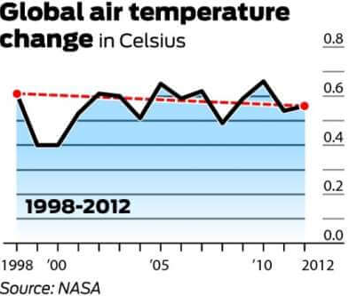
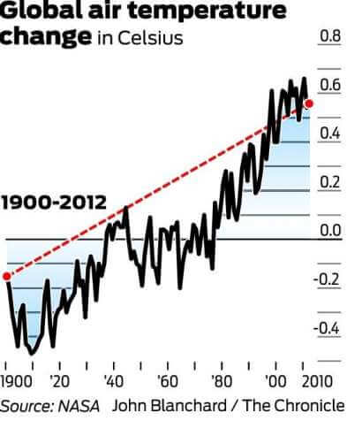
24
7
30
Topic: Statistics
Date: /06/2018
EQ – Can statistics tell lies?

Slide 9
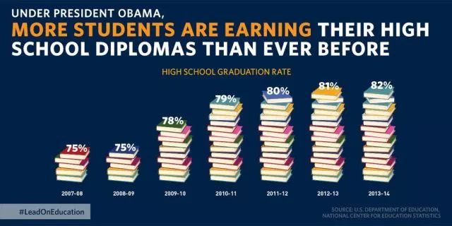
24
7
30
Topic: Statistics
Date: /06/2018
EQ – Can statistics tell lies?
The truncated y axis is a warning sign. The scale is another warning sign – 5 books is 75%, 16 books is 82%

Slide 10
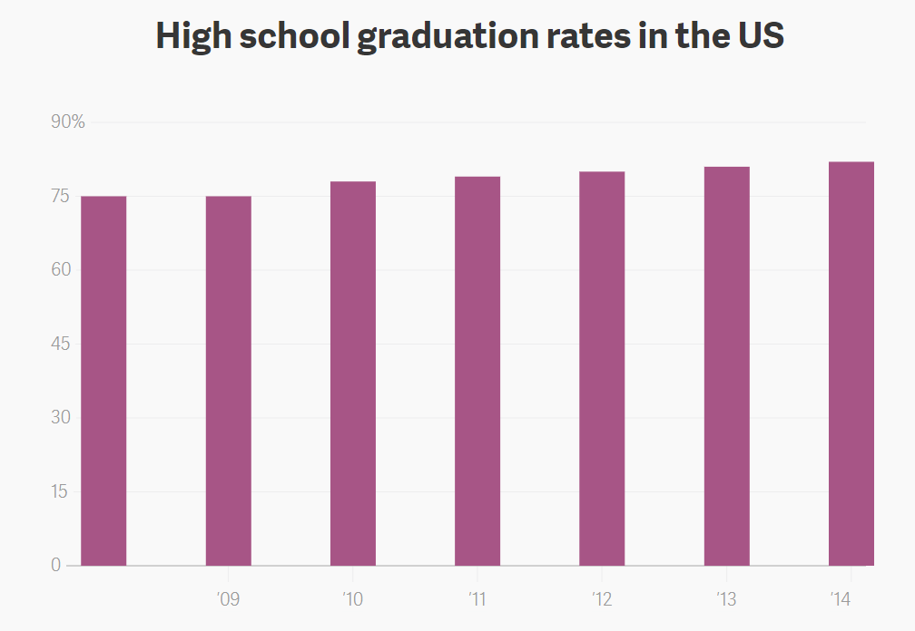
24
7
30
Topic: Statistics
Date: /06/2018
EQ – Can statistics tell lies?
Shown this way it shows only a very slight increase

Slide 11
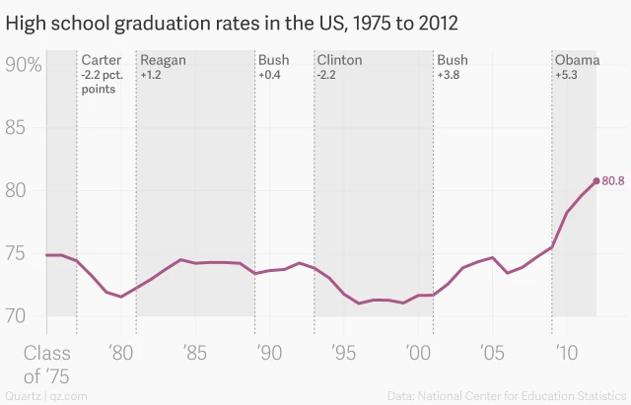
24
7
30
Topic: Statistics
Date: /06/2018
EQ – Can statistics tell lies?
If we look at the same data over a longer timeframe that there is a general increase that started in 2000 and continued in 2008 – 2012.

Slide 12
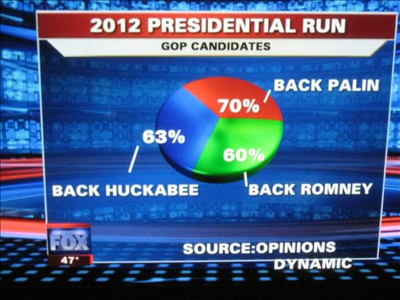
24
7
30
Topic: Statistics
Date: /06/2018
EQ – Can statistics tell lies?
Terrible…

Slide 13
24
7
30
Topic: Statistics
Date: /06/2018
EQ – Can statistics tell lies?
If we look at the same data over a longer timeframe that there is a general increase that started in 2000 and continued in 2008 – 2012.

Slide 14
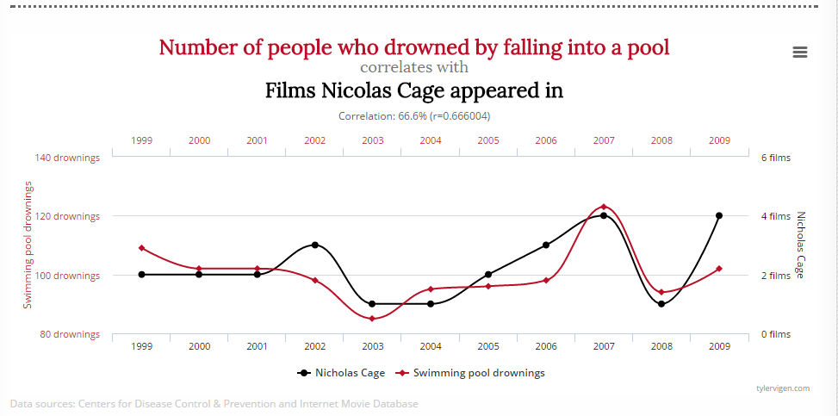
24
7
30
Topic: Statistics
Date: /06/2018
EQ – Can statistics tell lies?
Correct use of statistics is essential when making government policies
Solution: Kill Nicolas Cage and stop all pool drownings.

Slide 15
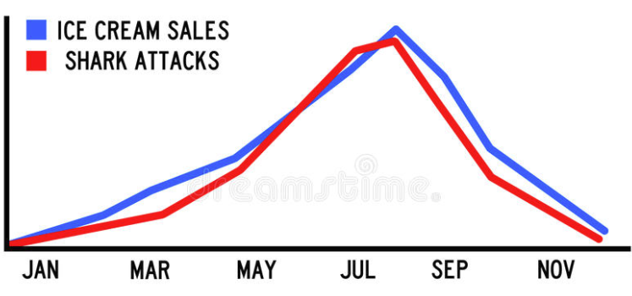
24
7
30
Topic: Statistics
Date: /06/2018
EQ – Can statistics tell lies?
Correct use of statistics is essential when making government policies
Solution: Ban ice cream and prevent all shark attacks

Slide 16
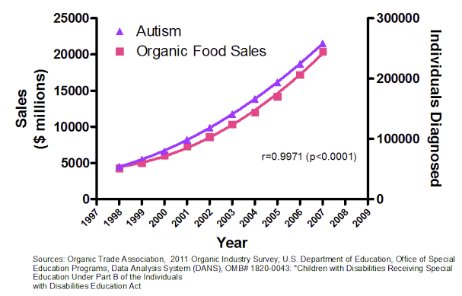
24
7
30
Topic: Statistics
Date: /06/2018
EQ – Can statistics tell lies?
Correct use of statistics is essential when making government policies
Solution: Ban organic food and cure Autism

Slide 17


Slide 18
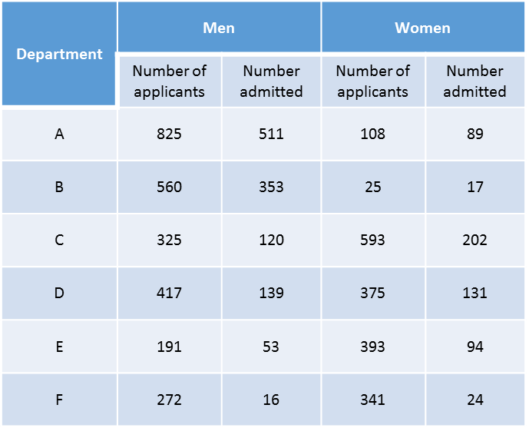
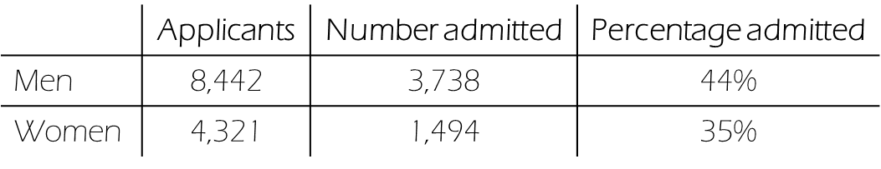
Task
People – we’ve got a problem!
Graduate school admission stats have just come through.
Are we opening ourselves up to a sex bias lawsuit?
Looked into this and we might have the exact opposite problem to worry about (departments left unnamed to protect the innocent):
Check out those percentages!
Compare the percentages and write two news headlines that tell the exact opposite story
Notes:
In 1973 the University of California in Berkeley accepted 44% of male applicants and 35% of female applicants to its graduate school. Concerned that it could be faced with an accusation of sex bias, the university investigated further. It was discovered that of its six departments, four accepted a higher proportion of female applicants, and the other two had only a very slightly higher percentage of males.
This is an example of Simpson’s paradox, in which one trend appears in several distinct groups of data, but when the data is combined the trend reverses or disappears. It was eventually concluded that women tended to apply to competitive departments with low admission rates while men applied to less competitive departments with high admission rates.
This case is intriguing and counter-intuitive. Students studying this example should be encouraged to research and design their own example of the paradox.

